Slide 1
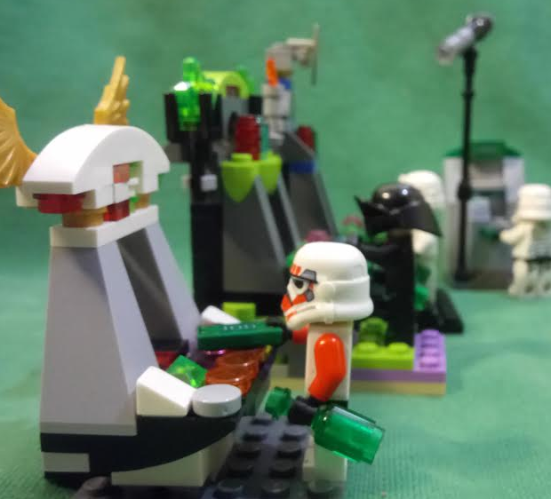
Electronic Gaming Machine
Testing
Notes:
Tonight I’ll be talking about poker machines or as I’ll probably call them most of the time EGMs
All the Lego images in this presentation are CC0 but the others are just random unverified images

Slide 2
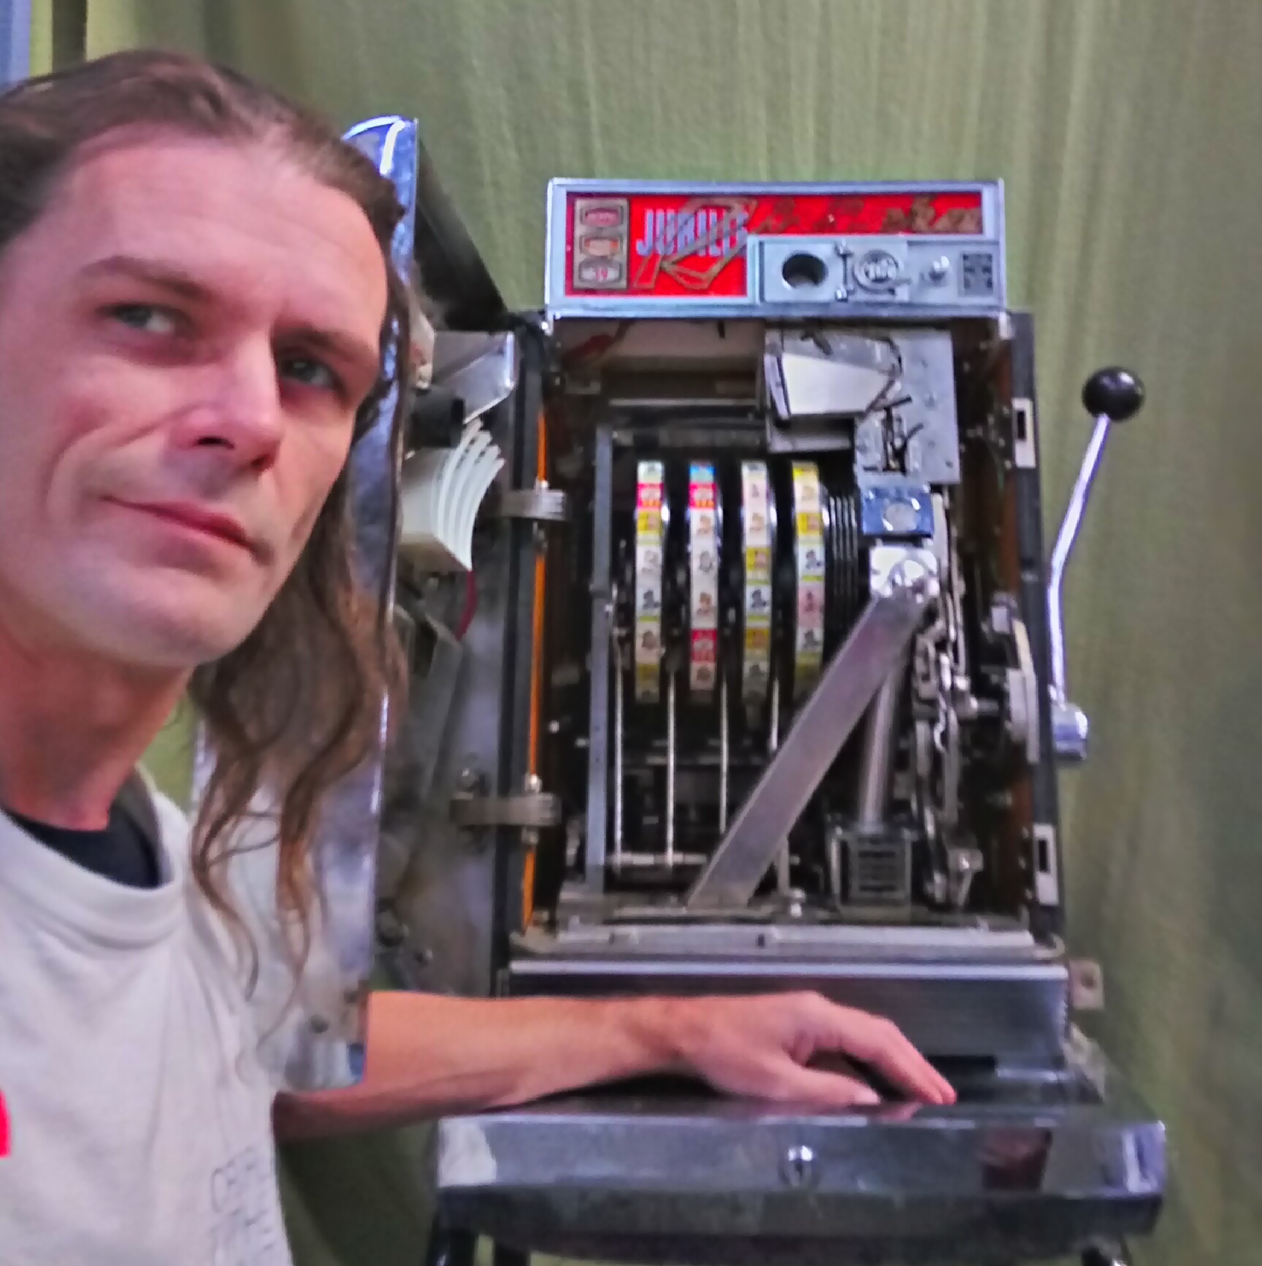
I am B.M.M.
I am not BMM
I am also PuZZleDucK
@_PuZZleDucK_
Notes:
I’ve been a GT for 8 years
But
I haven done it for over 6 months and things were changing
I don’t rep BMM or gaming in general
There are many variations and I worked a lot in semi regulated environments
My license just expired
Does Lego count?

Slide 3
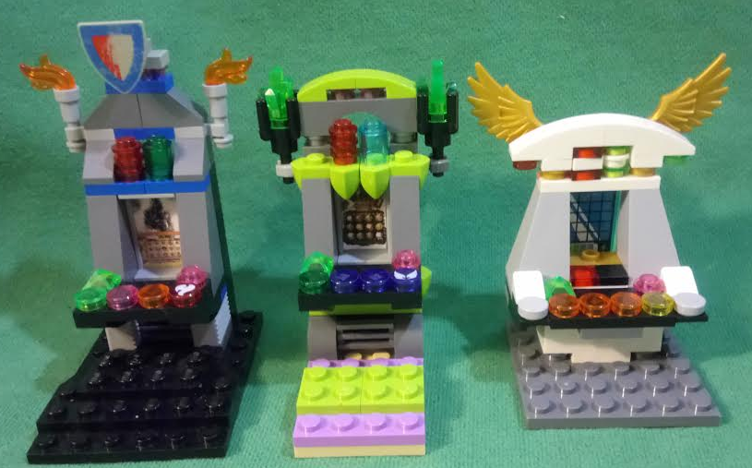
Jurisdiction Specifics
National Standards
+ State Appendix
+ Various Technical Standards
= Test coverage
Notes:
Testing amounts to verifying compliance with various standards
Often incompatible eg QLD vs NSW comms
Player information and interface requirements
Minimum and maximum limits such as bets/RTPs/double-ups
Subtle and poorly documented jurisdictional precedents make for tricky and subtle variations
Periods of validity for a standard can overlap with later standards so we could be testing to 5 year old standards

Slide 4
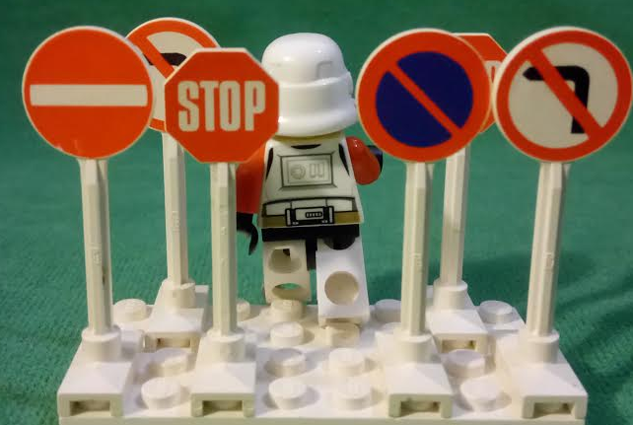
Rules of the Game
and how to break (some) of them
Notes:
The first rule of poker machines is there is never any variation in payout based on skill
All buttons are equal, $100 bet $1 at a time is the same as a single $100 bet (statistically)
All choices have equal statistical payouts unless stated (in which case they are always very close)

Slide 5
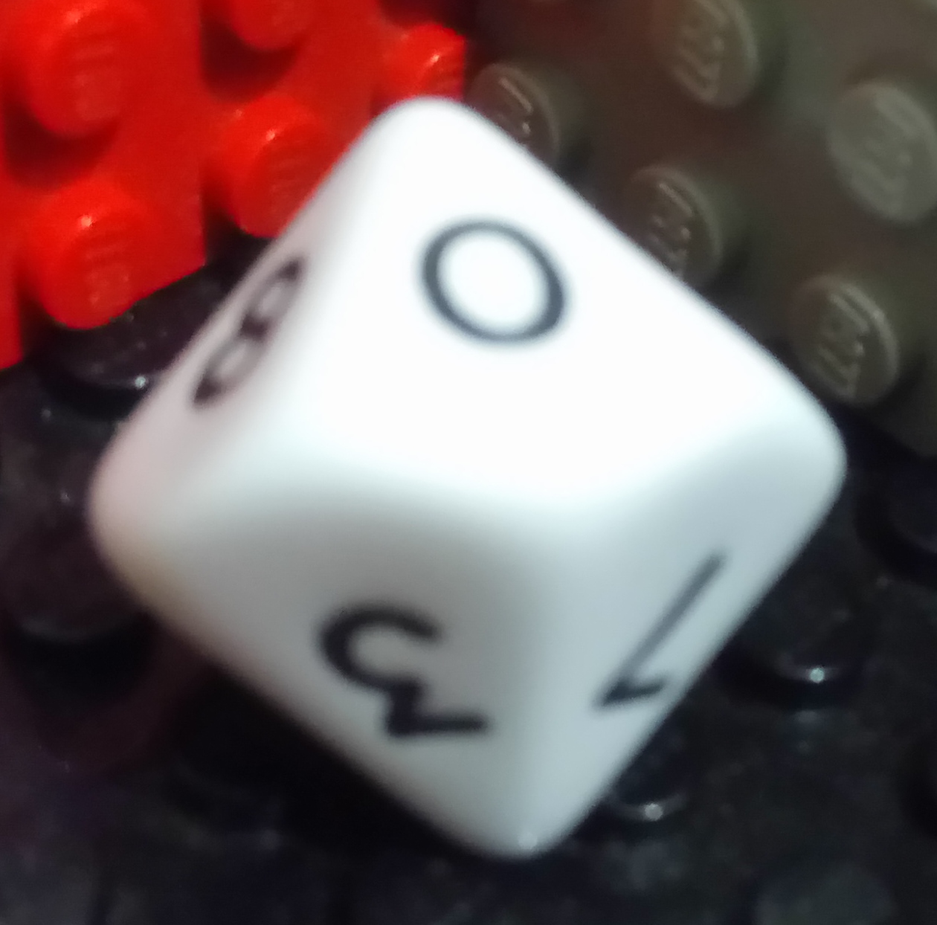
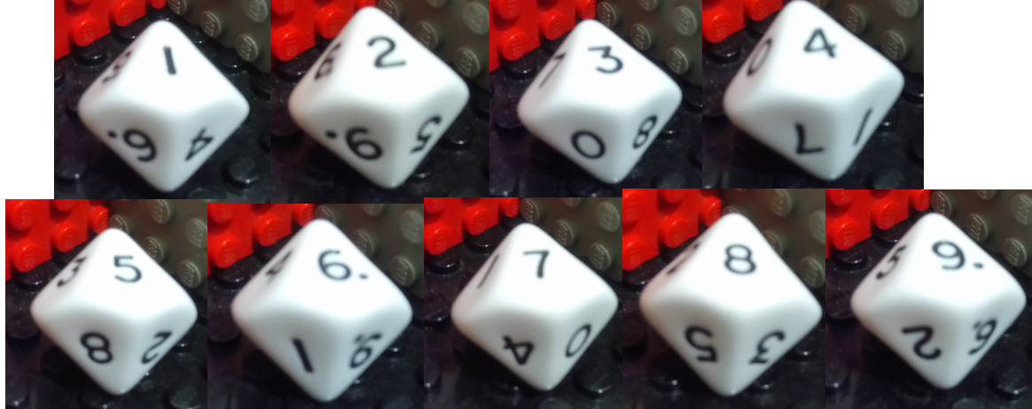
RTP
Win!!
$10
100% RTP
(and illegal)
Lose
$0
Win!!
$8.50 ~
$9.00
Step right up, just $1 per spin
85~90% RTP
(approx range)
Lose
$0
Notes:
The rules are always the same… all about the mathematical RTP
For an RTP of 90% then 100 -> 90 -> 81 -> … -> 0
Everyone always asks about “changing the return while playing”… possible but unlikely… eg in QLD changing the RTP technically only requires a remote system sending a single message, but also involves paperwork and approvals and triggers all kind of checks and balances

Slide 6
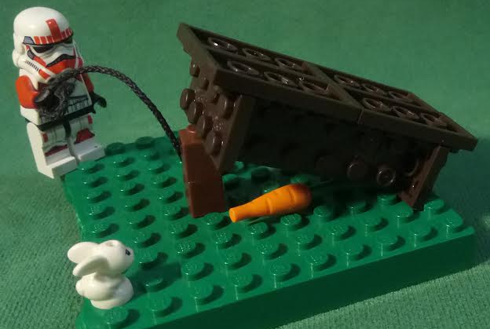
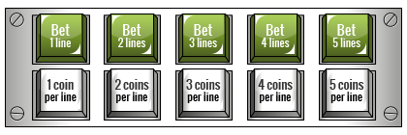
Tradeoffs
No such thing as a free lunch (just fancy carrot-math)
Notes:
RTP must be maintained how can we add a JP or have different buttons
Short answer: we must reduce RTP or increase the cost
Playing more lines increases wins in linear proportion to bet
Same with bet/line
For a JP or bonus we could have less wins on the reels or reduce a symbols pay and trade off lots of small wins for a single big win
Jackpots end up having their own RTP based of SUP and INC so the effect of adding a JP config is easily determined

Slide 7
The Reels
Notes:
This little demo is an example of a six symbol reel rotating as the player would see it
Must represent physical reels and spin perpendicular to view of play
Game display and outcome but be determined by one number for each reel and the mapping of symbols
Looping around lust like a physical reel would
Easy to side step these rules with “wheels”

Slide 8
The Exception to the Reels
Notes:
By spinning the axis of rotation we can exempt ourselves from the regulations on reels
Now we can simulate or dynamically generate the symbols
Similar exemption are made for overlays and mini-reels
But now the maths must be representative of the display

Slide 9

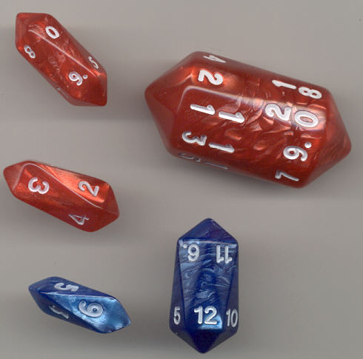
The Exception to, the Exception to the Reels
Clarity and
Integrity of Representations
Notes:
Now our little demo is more like the EGMs in WA where reels are not legal, each symbols position is determined at random and there is no correlation between symbols
Legislation still requires art to be representative of reality
Can’t show a standard dice if the probability isn’t ⅙ or a coin if it’s ½
Requirement to be clear and understandable

Slide 10
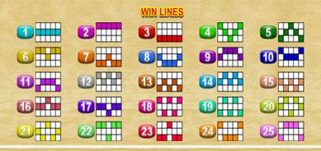
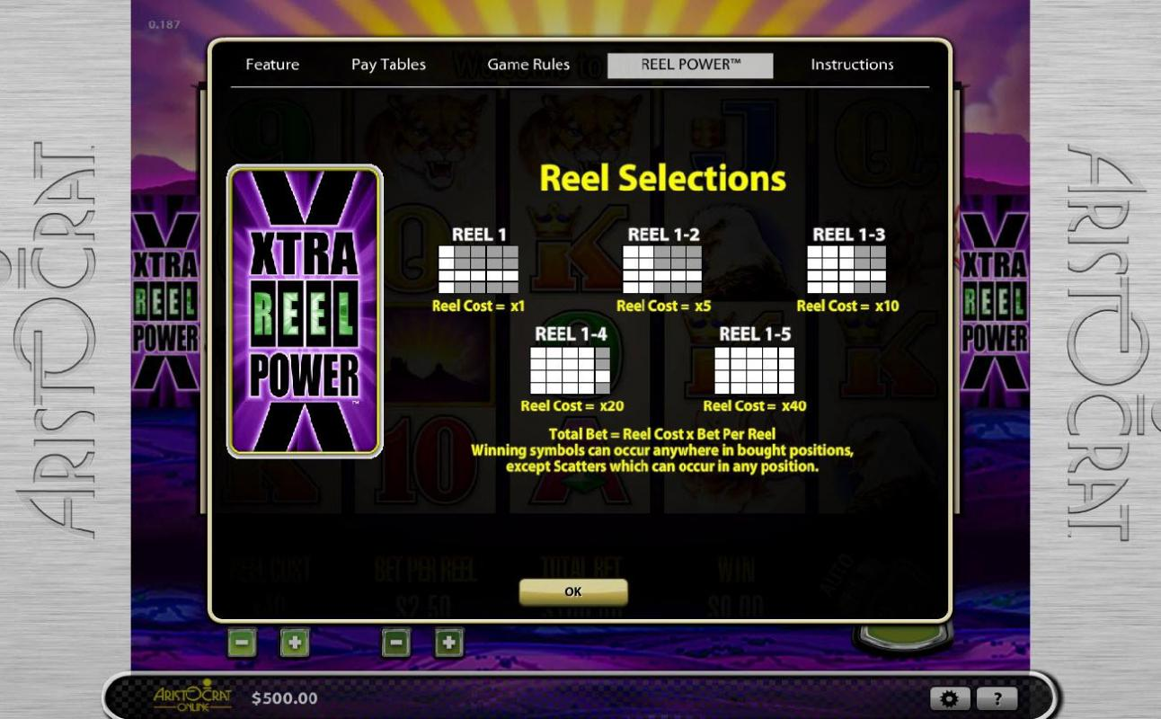
Lines, Ways and Scatters
Play Window
Reel 1
scatter
Anyscat
Anyscat
Line 1
any
any
any
scatter
scatter
Anyscat
Active
Inactive
Notes:
Other than the usual pay order there is also r2l, both or any
Lines seem simple enough to me now but explain helpscreens
This is another example of sidestepping requirements as there used to be limits on the number of lines but patterns are exempt from this restriction
Scatters are often misunderstood to mean pay any, but actually means pay off the line/area

Slide 11
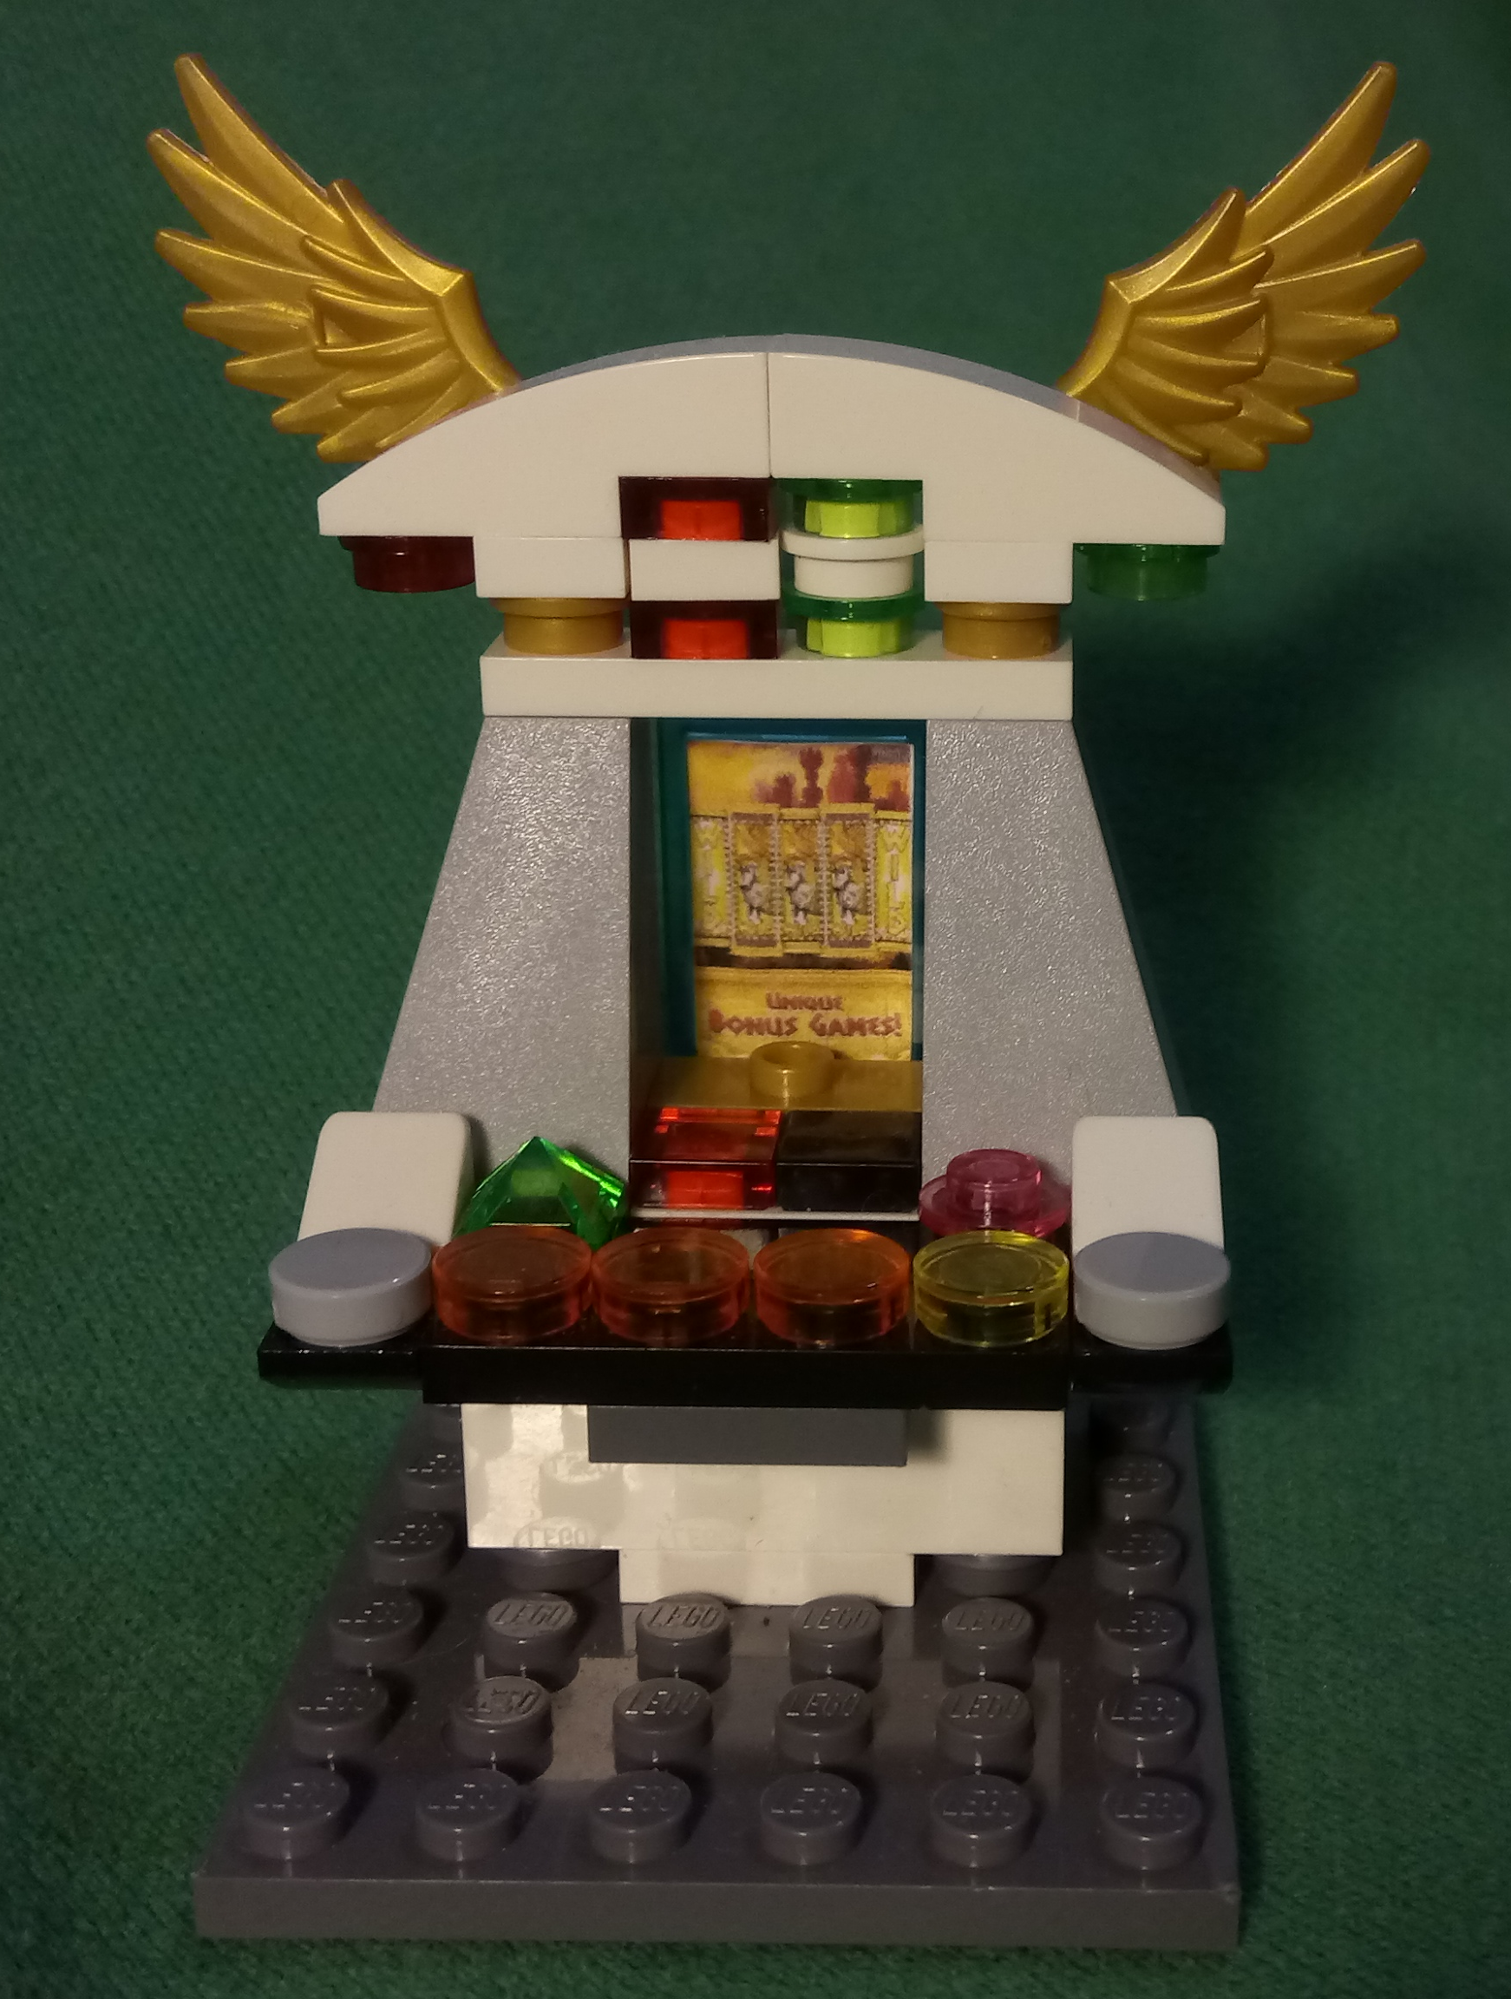
Substitutes, Jackpots and Bonus Wins
Notes:
Substitutes are wild but can have extended clauses and conditions
Jackpots are often triggered by reel combinations but
could also be the inappropriately named “mystery” style where the award amount is predetermined
JP triggers and substitutes often have subtle and unexpected dependencies
Bonus prizes are except from almost all requirements other than clarity

Slide 12
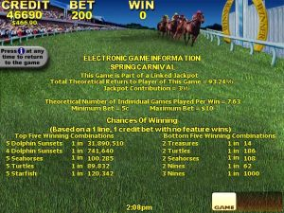
Help and Player Info
Notes:
Another point of contention between jurisdictions is help and information interfaces
Most players don’t read help screens but are necessary legal mechanisms
Eg if the rules state that only 1 jp per game occurs and somehow 10 jps happen then it is clearly a fault and the game is void inversely a game may double some winnings and loose rules could enable a player to sue for expected winnings
Rtp & top5/bottom5
Spend per minute/hour was great in QLD it expressed what the RTP meant
$5~$60 per hour and ~ $600 bigger in casinos

Slide 13
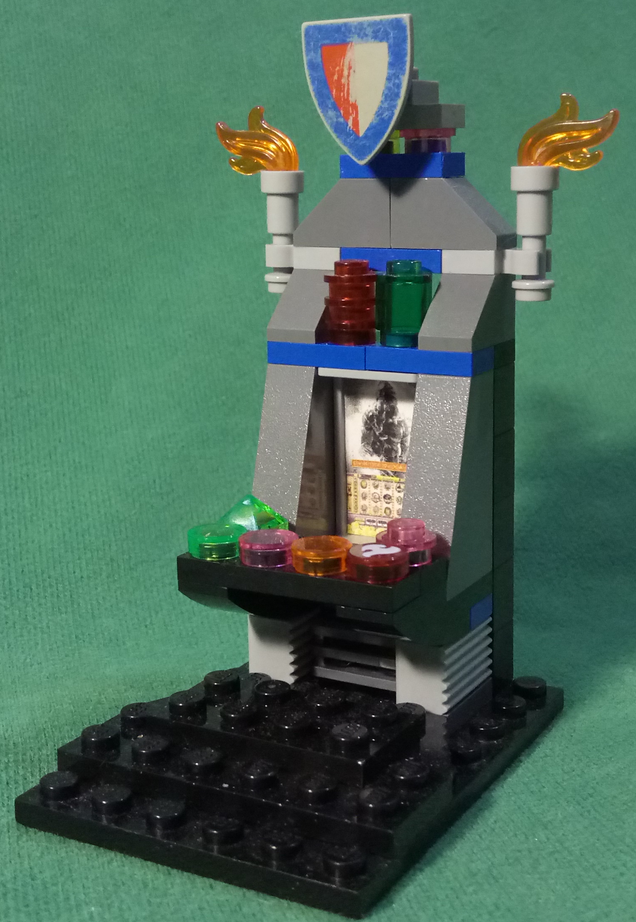
The Cabinet
Notes:
Lots of regulations about locks, physical security and integrity
Only verified on hardware updates
The button panel, external artworks and topboxes are what we look at for a game

Slide 14
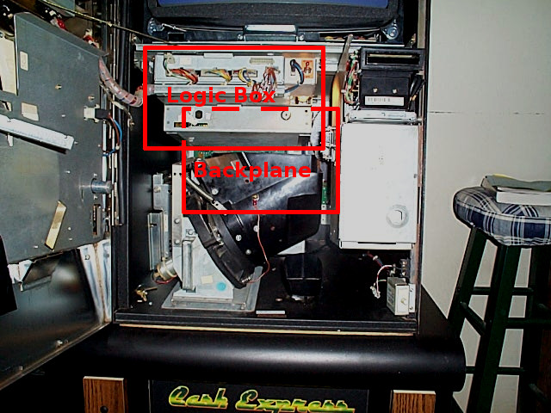
Inside:
Logic Box &
Backplane
Notes:
Lets have a look inside, central to it all is the
Logic box for program, rng, and critical memory
Critical memory must be triplicated on nv-ram and constantly verified
If faults occur the machine is not to perform any operations
Serial ports for monitoring systems, JPs and debugging are also found in here
Backplane - connector city

Slide 15
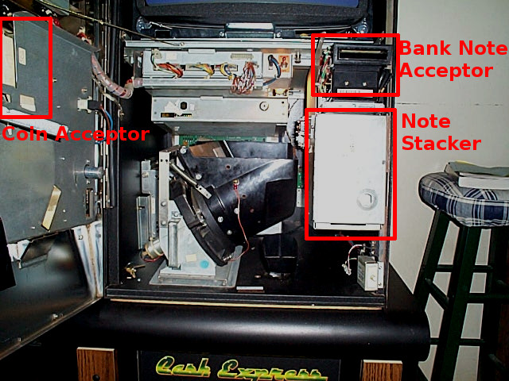
Inside:
Money In
Notes:
The Coin acceptors are normally mounted on the doors
Tested for acceptance, rejects, jams, yo-yos
And note acceptors on the right with similar tests in addition to the different values
Note stacker below with security cage
Good example of the separation of responsibilities, attendants can get into the hopper easily, but need a another key to get the stacker

Slide 16
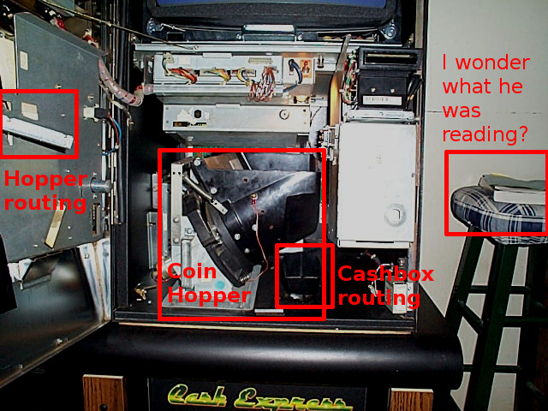
Inside:
Money Out
Notes:
Hopper takes up the bulk of the space in the front and is tested for jams, overpays and other faults
Unfortunately there is no printer depicted here but it’s usually opposite or above the note acceptor
mechanical routing for coins can also bee seen in parts here and we test the servo and sensor behavior of these also

Slide 17
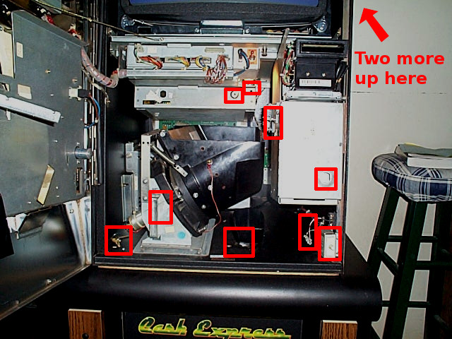
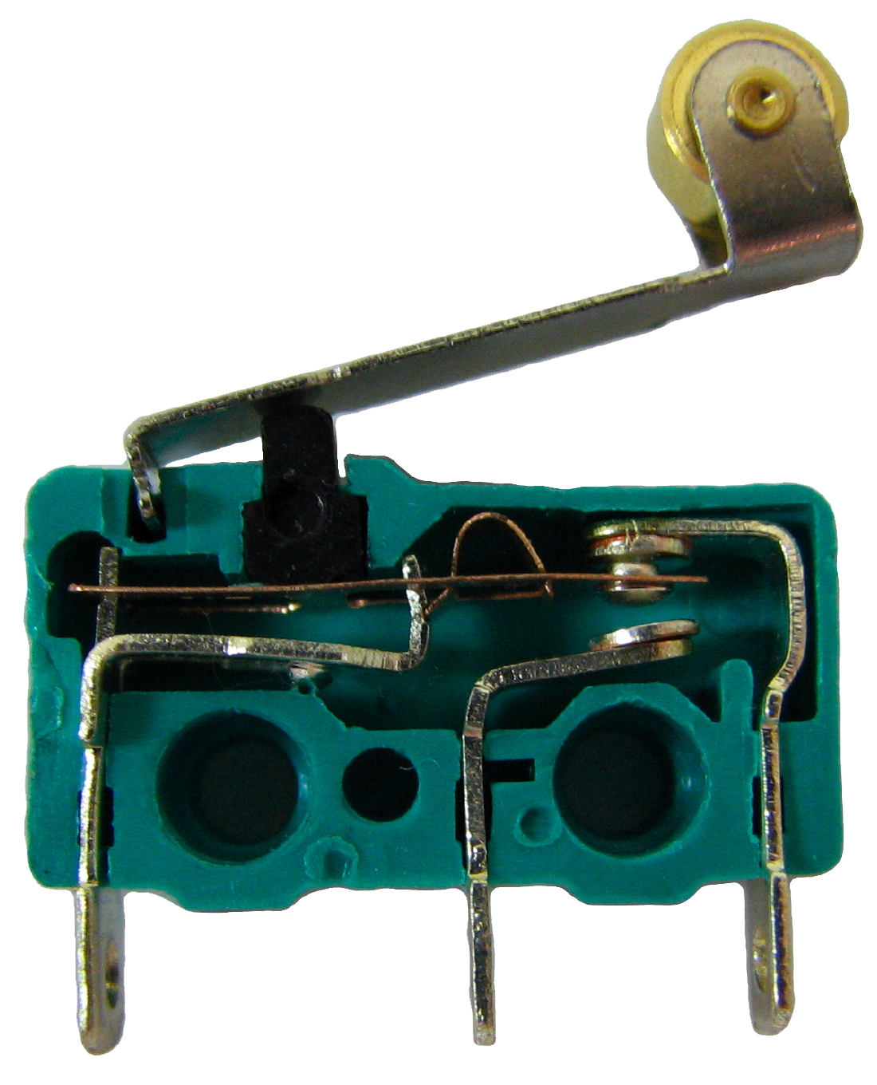
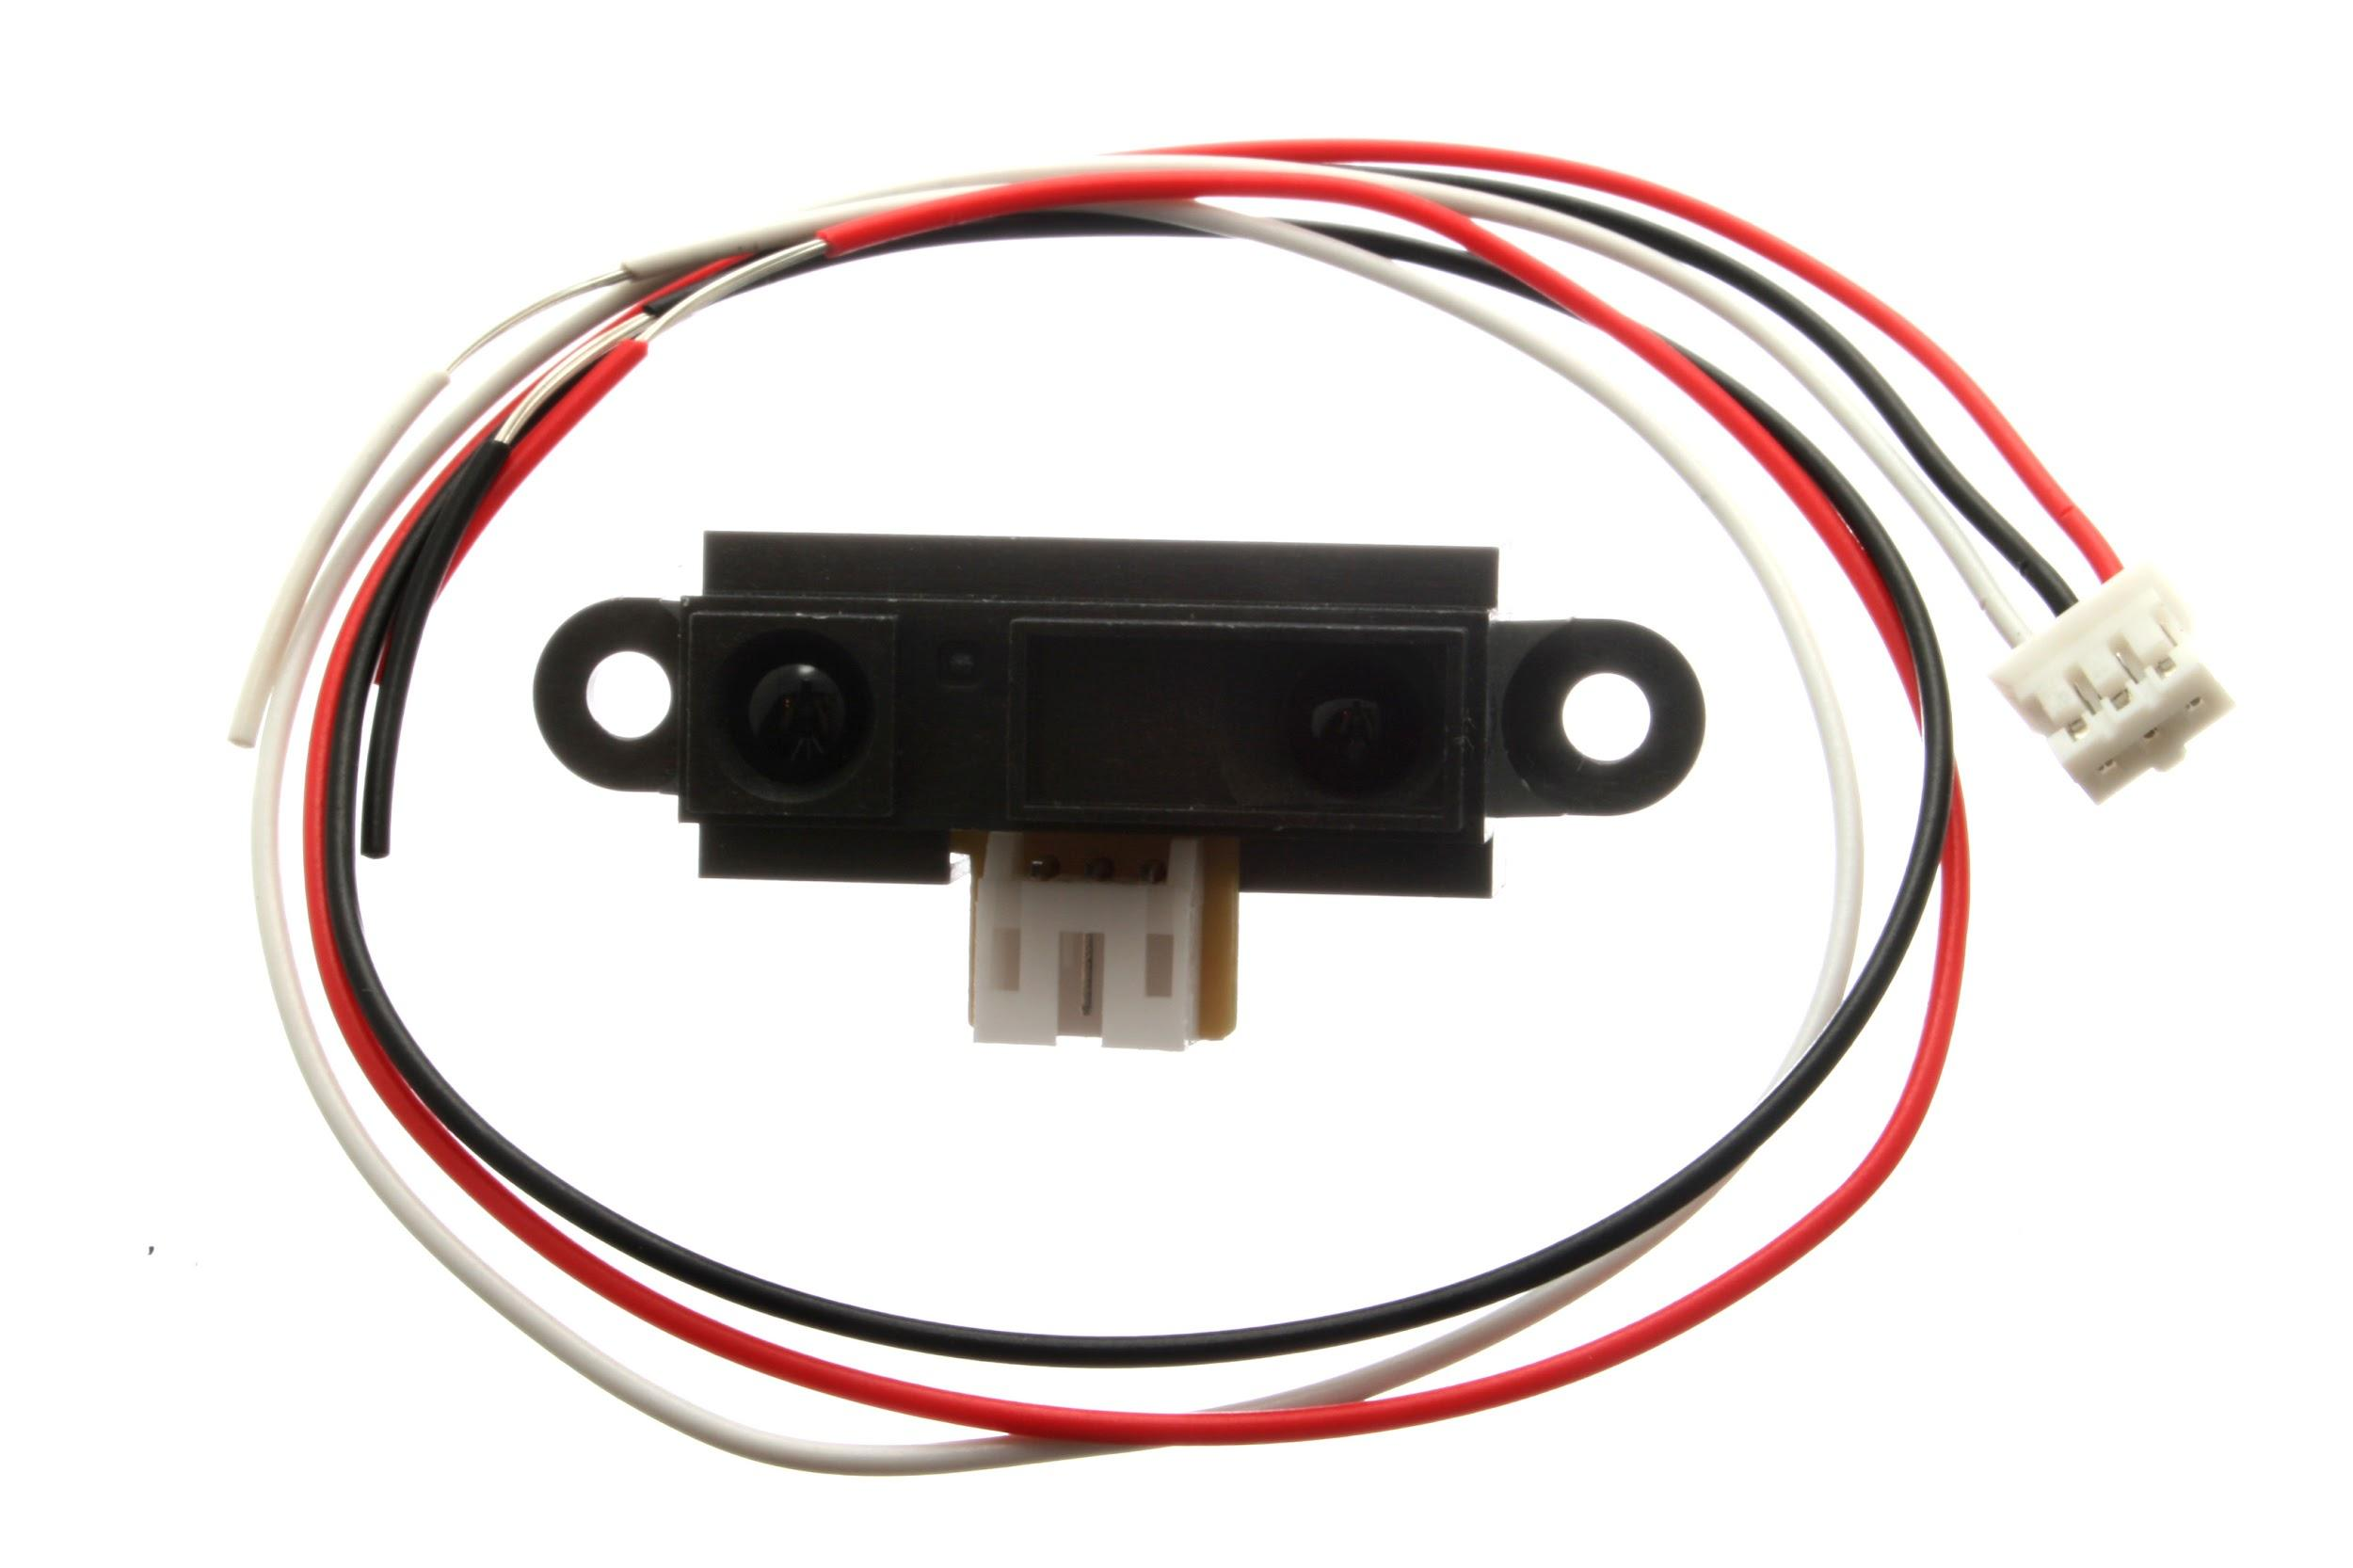
Inside:
Doors and Locks
Notes:
Mechanical and optical switching monitors door access
Some doors have requirements for multiple monitoring methods and unpowered entry detection
Depending on key positions some door accesses are valid such as an authorized attendant performing a cash clearance

Slide 18
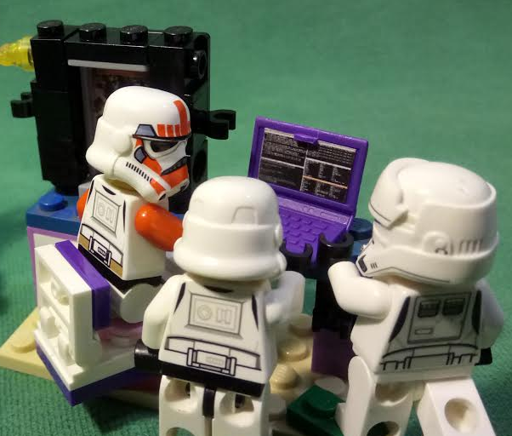
Platform
Base
Game
[Version]
“Our budget won’t allow us to buy a segregation of duties software package …
So the auditor said we will all have to press the enter key together”
Notes:
The software is separated into Game Platform and Base
Reality is much messier
Two extremes that sum this up nicely are where some games are submitted in the form of artwork and speadsheets that treated all game events like a reel spin which simplified testing and verification
On the other end of the spectrum some manufacturers submitted entire systems complete with linux kernels for the game

Slide 19

Checklists
and checklists of checklists… all reviewed by checklist
(actual dependency graph)
Notes:
Much as to some manufacturers any rng is a reel… so in the lab, any problem is a checklist
Lots of duplication and dependencies, tooling could help
Customization of these tests is the real secret sauce of BMM (experience in checklist form)
I found it helpful to think of them like the famed “testing tours” and this helped give a context aware flavor to the testing
Step one is to evaluate what testing must be performed for this software in this jurisdiction
Lets look at the QCOM standard checklist

Slide 20
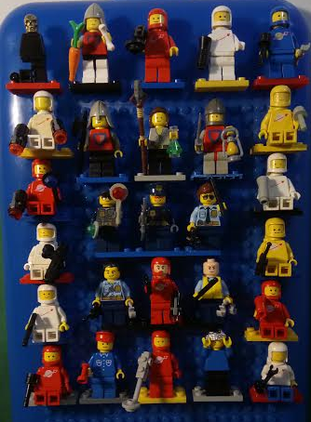

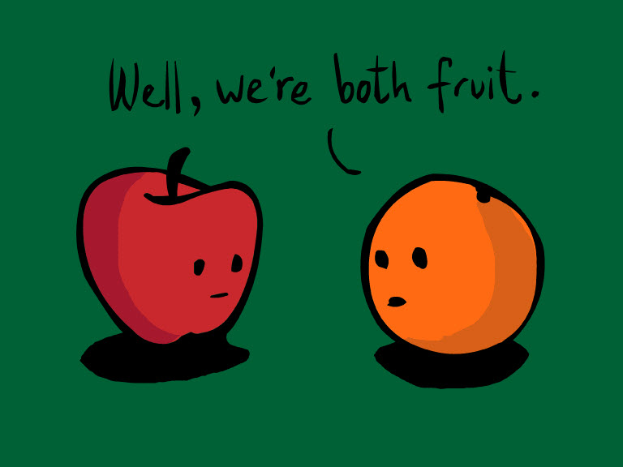
Software Provenance
Notes:
Next we want to minimize the work to be done by determining the most similar games, platform and base software
Then by comparing previous games to the game under test we can (hopefully) rule out many of the potential tests
We must also verify the build of the software under test and verify its binary hash
This hash can be used to verify the software on site of if it was tested at another testlab

Slide 21
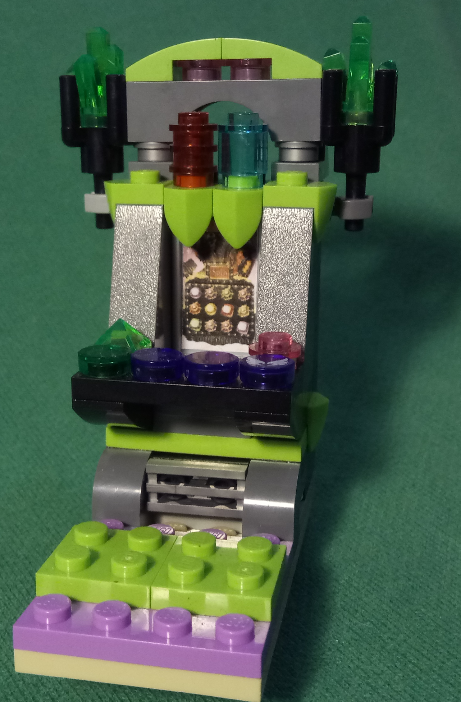
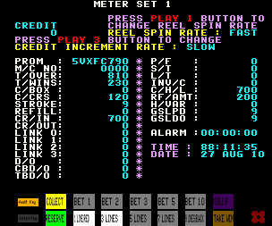
Regression
Notes:
Don’t be fooled by the name, the regression test has no resemblance to how the term is used elsewhere
Verifying basic accounting and functionality
Exploring the game rules and display
Verifying everything matches
Basic faults and failures

Slide 22
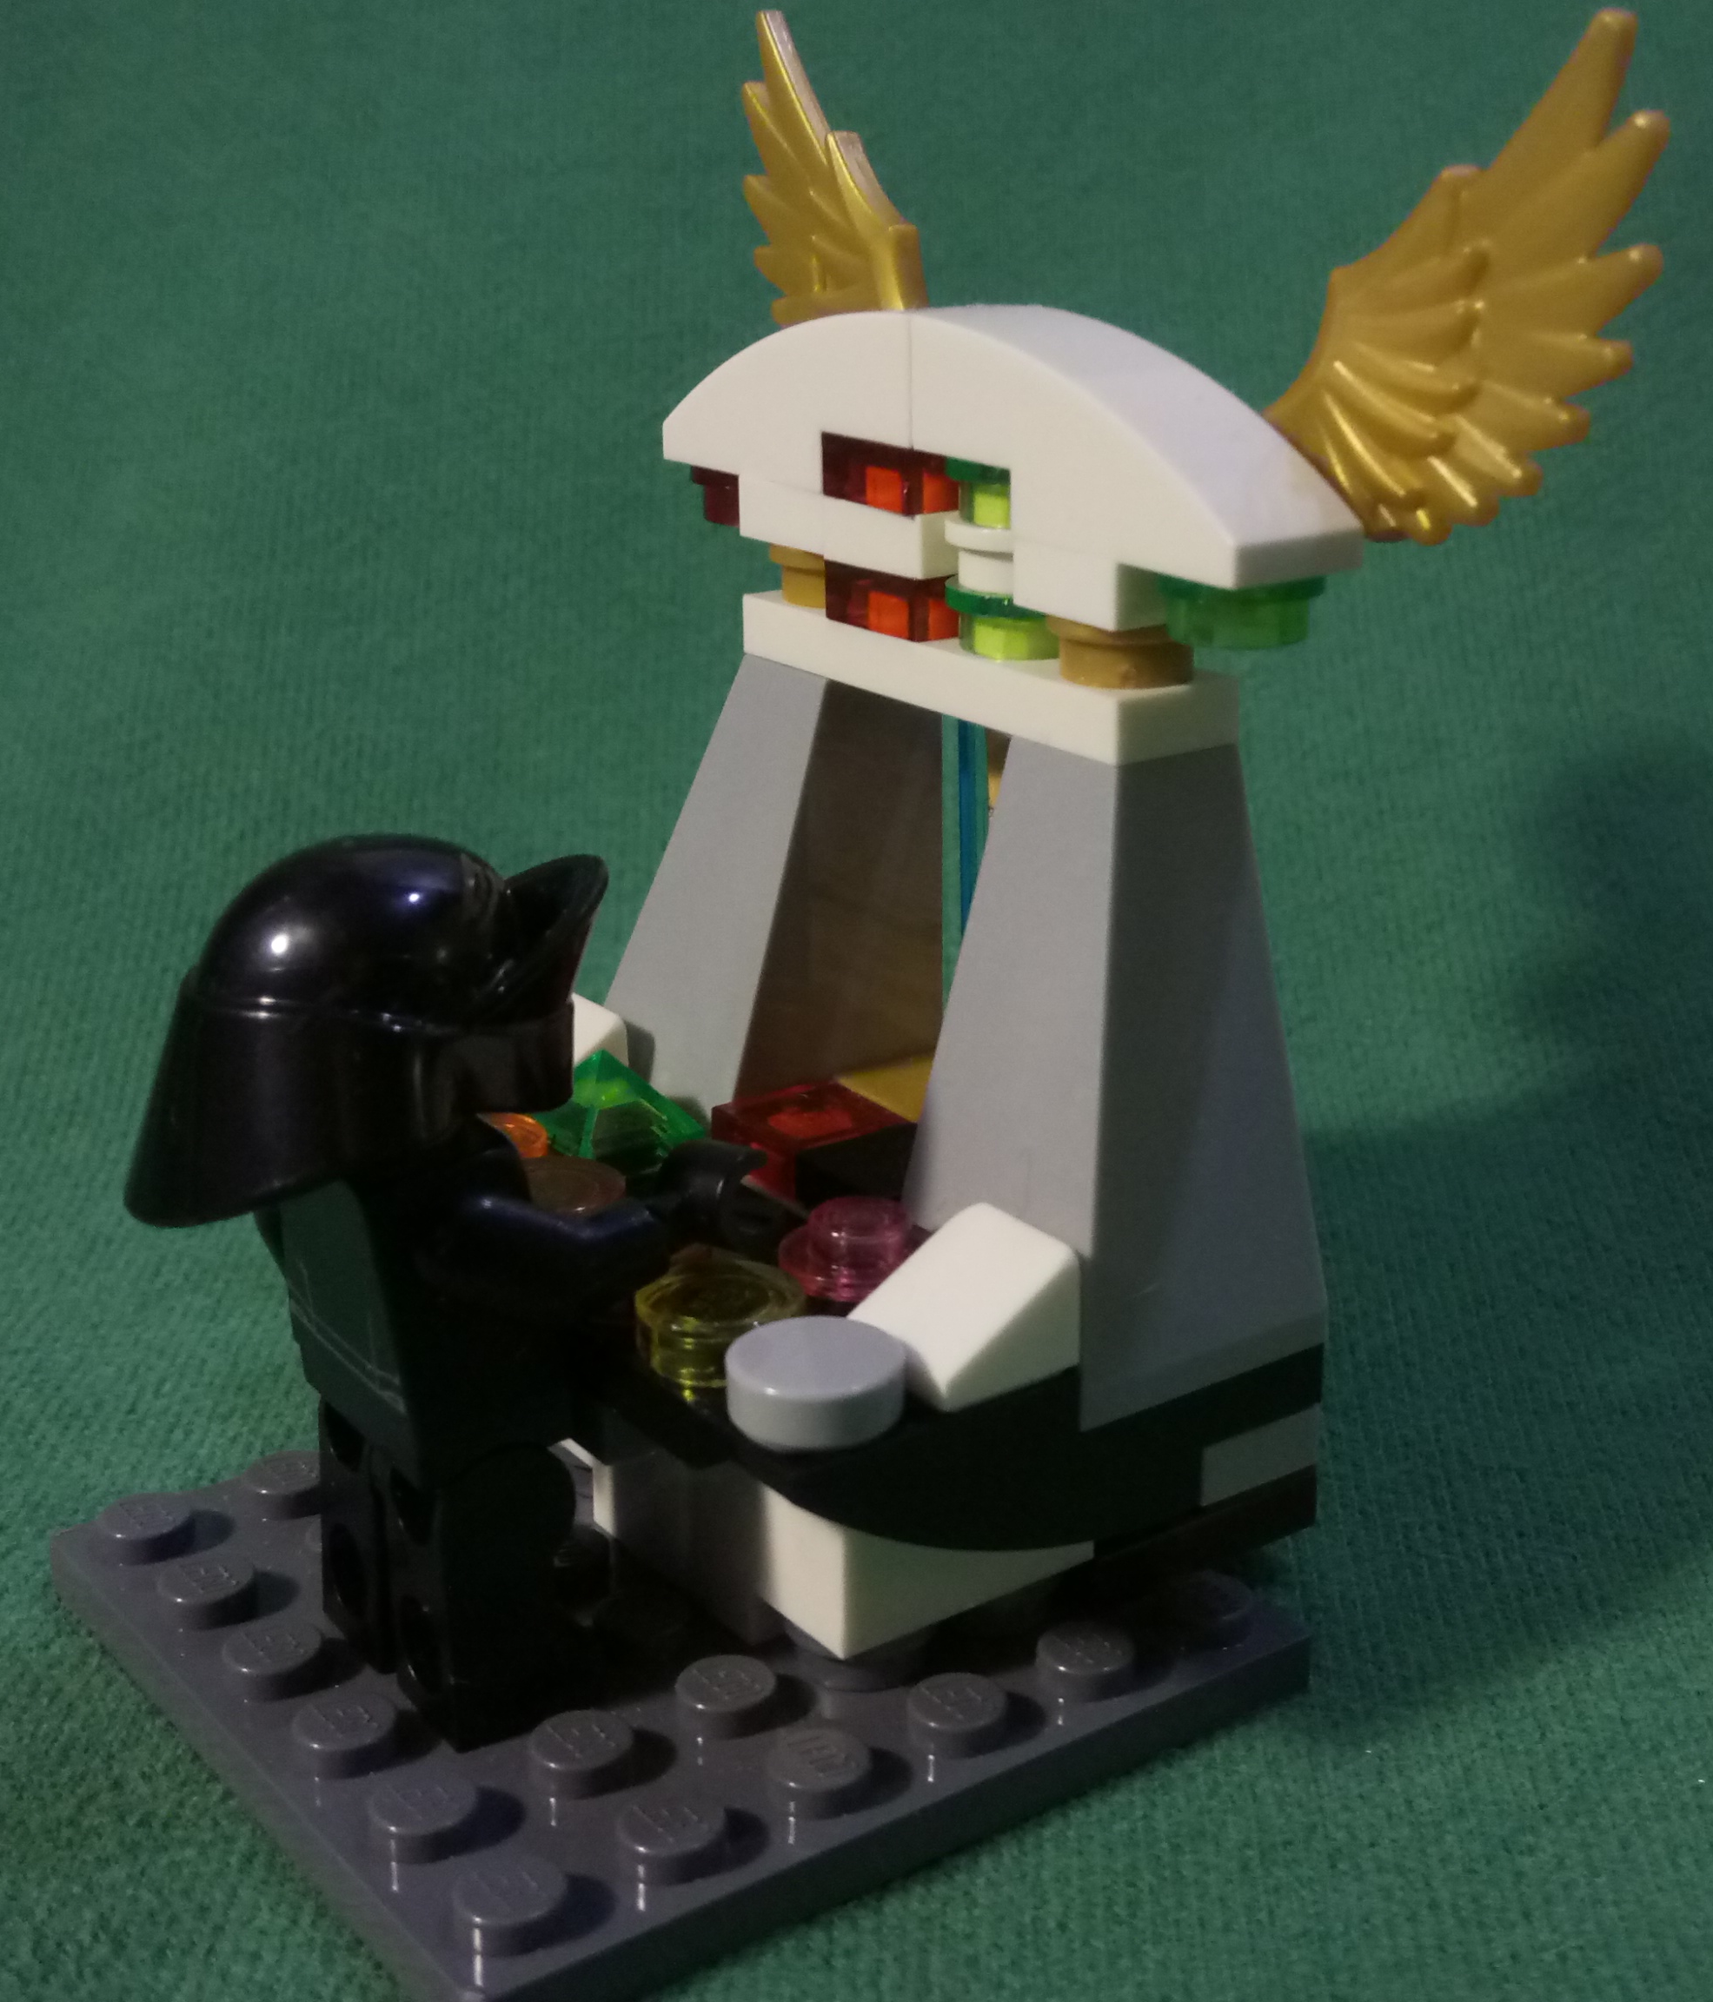

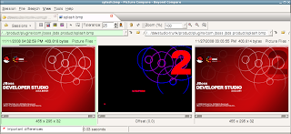
Artwork Verification
Notes:
Subjective judgments on clarity are based mostly on precedents
Artwork in the source code may not be used or displayed as is so the verification of matching is important here
Often changed artwork may just be regenerated or a little more shiny like our first example
Tooling makes the review as quick as possible, but each changed image should be viewed and analyzed if necessary
A lot of rules are innocuous by themselves but interact in unexpected ways giving rise to complex systems

Slide 23
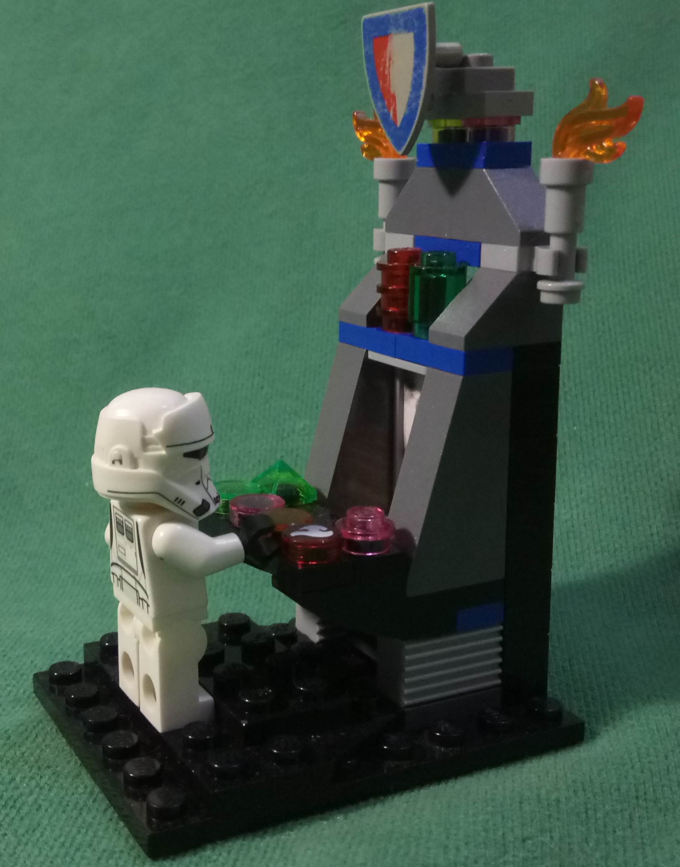
Jurisdiction Compliance
Notes:
Biggest jurisdictional differences are in communications and these can involve subtle differences in definitions
An iconic example is QLDs definition of RTP to not include progressive components and differing interpretation of progressive components

Slide 24
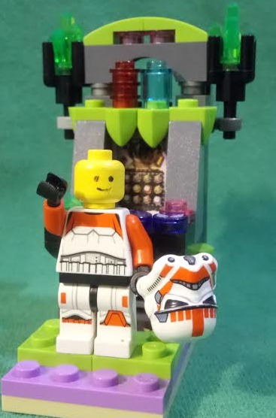
Maths and Combinations
Notes:
We request a mathematical analysis ASAP in the project, but provenance must be known first as the game may already exist in another form
In the combination test we use the math results to verify every possible win and every possible symbol on every possible configuration
Requires understanding of individual game and supporting platform
Highly customized
Fragile and prone to disruption
Time consuming and difficult to automate… flexibility vs stability

Slide 25

Open Source Inside
Notes:
So the punchline of this talk originally was that the majority of machines run linux
And in my case was additionally tested entirely on linux too
Questions? Comments!

